Slide 1

Beyond the Scan: Preventing Burnout in Medical Imaging
Kelsey phelan
Athabasca university
MHST 631
Health Promotion i: foundation
Notes:
Hello Everyone My name is Kelsey Phelan
today we are looking at Beyond the scan- preventing burnout in medical imaging.
Medical radiation technologists are a smaller group that are often forgotten –
we are often the first people to know someone has cancer or their condition has worsened but we can’t say anything we just smile and help the patient up and on their way and confirm we got what the dr needed
Mental health still has a stigma so many are still afraid to talk about it
Recent mental health surveys from the Canadian association of medical radiation technologists showed that 64% of MRTs are stressed all the time

Slide 2

Burnout in MRTs
Short staffing
Higher demand
Stressful, draining job
No support from management
Unhappy work culture leading to people leaving
Notes:
Most medical imaging departments are short staffed and have been for a long time
Many report having too much work for the number of people
The demand for imaging increases each year but the resources aren’t increasing to match the demand
It can be a mentally stressful job on the best of days.
COVID-19 made things worse and many departments have still not caught up
Staff feel more pressure to do more with less but report little support from management
Because of all of the above people are leaving the field which creates more stress on the people that are left
There is no one to replace them because there is a Canada wide shortage of medical radiation technologists

Slide 3

Population
Population – Medical Radiation Technologists
QEH Diagnostic Imaging Department
Notes:
For the purpose of this assignment I will look at MRTs at the Queen Elizabeth Hospital. It is the largest hospital and has the widest variety of modalities, xray, CT, Mammography, MRI, Nuclear medicine and radiation therapy.
It will have the most resources and wide variety of people for the test group with hopes to expand to the other hospitals once things are successful so that everyone gets the help they need

Slide 4

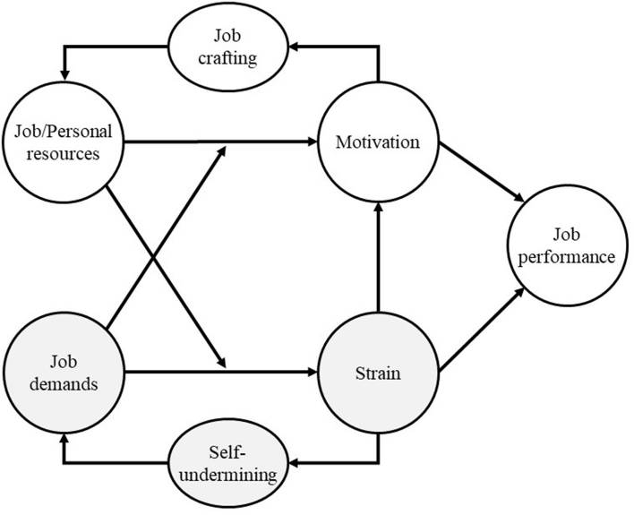
Job demands-resources theory:
Notes:
One theory I will explore is Job Demands-Resources explains how high job demands (workload, time pressure, emotional labor) drain energy and predict exhaustion, while job resources (staffing, autonomy, supportive leadership, peer support) buffer demands and promote engagement—key for burnout prevention
https://psycnet.apa.org/fulltext/2024-98655-004.html

Slide 5
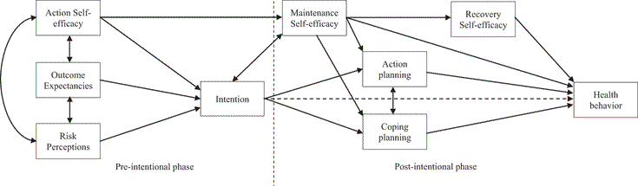
Health Action Process Approach (HAPA)
Notes:
The second theory I will explore is Health Action process approach — bridge intention → action → maintenance
Why this theory: Many staff intend to be active but don’t translate that into routine. HAPA adds action planning, coping planning, and self-efficacy to close the intention–behavior gap; r
reviews show HAPA- programs increase frequency/duration/intensity.
How it informs the program:
Action plans: “When/where/how” micro-plans tied to shift patterns (e.g., 10-minute walk after last patient; stretch set during coil cleaning).
Coping plans: pre-decide responses to barriers (overruns, fatigue, weather).
Self-monitoring: simple logs or badges; periodic check-ins to recalibrate plans.

Slide 6

Thanks
Notes:
Thanks for you time and attention to my health promotion proposal

Slide 7
References
Bakker, A. B., & Demerouti, E. (2024). Job demands–resources theory: Frequently Asked Questions. Journal of Occupational Health Psychology, 29(3), 188–200. https://doi.org/10.1037/ocp0000376
Canadian Association of Medical Radiation Technologists. (2021). CAMRT Mental Health Survey 2021. https://www.camrt.ca/wp-content/uploads/2021/10/CAMRT-National-Mental-Health-Survey-2021.pdf
Zhang, C.-Q., Zhang, R., Schwarzer, R., & Hagger, M. S. (2019). A meta-analysis of the health action process approach.Health Psychology, 38(7), 623–637. https://doi.org/10.1037/hea0000728

